Slide 1
Smarter Reconciliation and Anomaly Detection using Gen AI
Solution Overview:
Our solution aims to identify anomalies in financial transactions by analyzing historical account data. We developed a robust script that reads account information from a CSV file, calculates the difference between two balance fields, and determines whether each transaction is a match or a break based on historical behavior. Specifically, it flags accounts as anomalous when a sudden deviation is observed after a consistent history of zero differences. The complete codebase and demo are available in the linked Git repository.

Slide 2
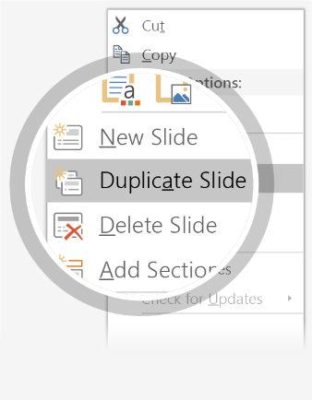
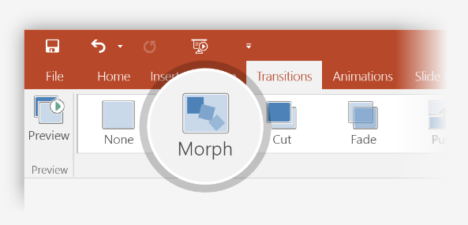

Setting up Morph
Try it yourself with these two simple “planets”:
1
Duplicate this slide: Right-click the slide thumbnail and select Duplicate Slide.
2
In the second of these two identical slides, change the shapes on the right in some way (move, resize, change color), then go to Transitions > Morph.
3
Return to the first of the two slides and press Slide Show button and then select Play to see your circle morph!
Hint: Effect Options gives you even more options for Morph.

Slide 3
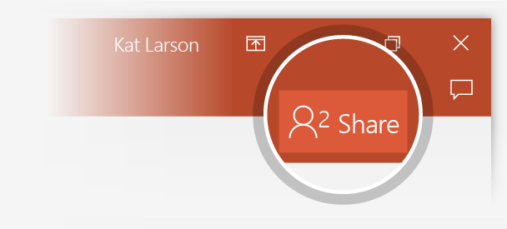
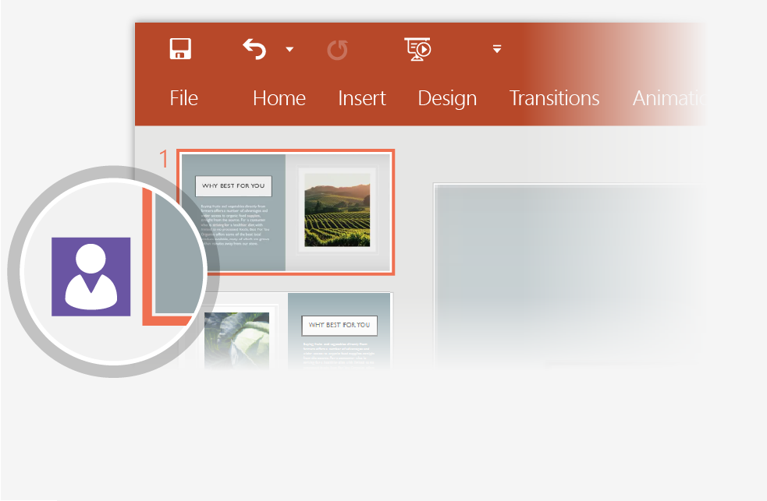
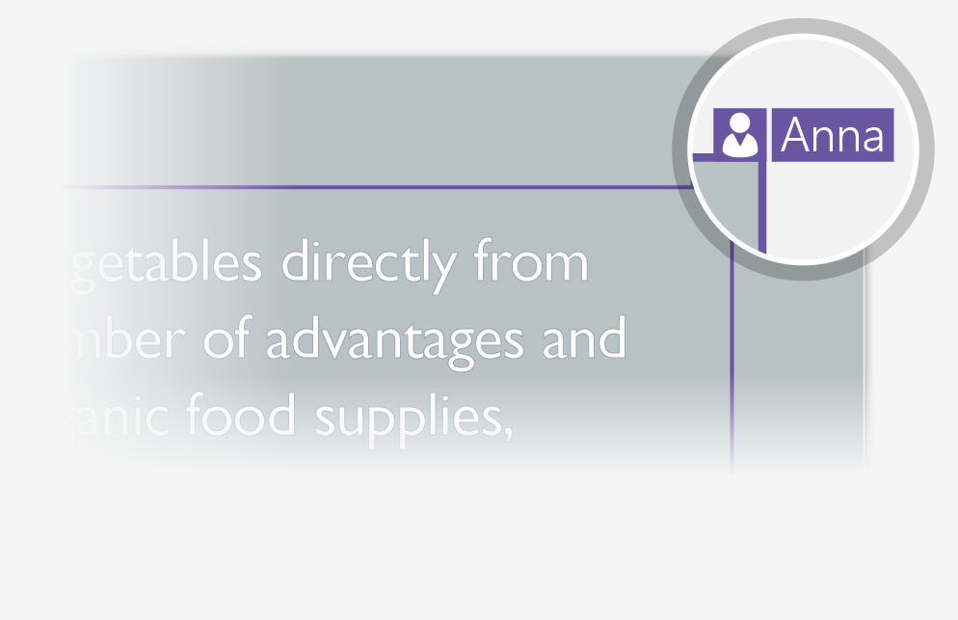
Working together in real time
When you share your presentation with others, you’ll see them working with you at the same time. How it works:
1
Select Share from above the ribbon, or by using short-key Alt-ZS, to invite people to work with you (You can save to the cloud at this point.)
2
When other people are in the presentation, a marker shows who is on which slide…
3
…and the part of the slide they're editing.

Slide 4


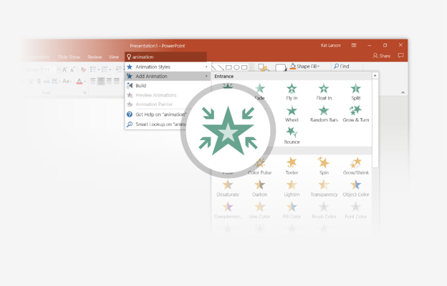
You’re an expert with Tell Me
The Tell Me box finds the right command when you need it, so you can save time and focus on your work. Try it:
SELECT ME
1
Select the Robot picture on the right.
2
Type animation in the Tell Me box, and then choose Add Animation.
3
Choose an animation effect, like Zoom, and watch what happens.

Slide 5
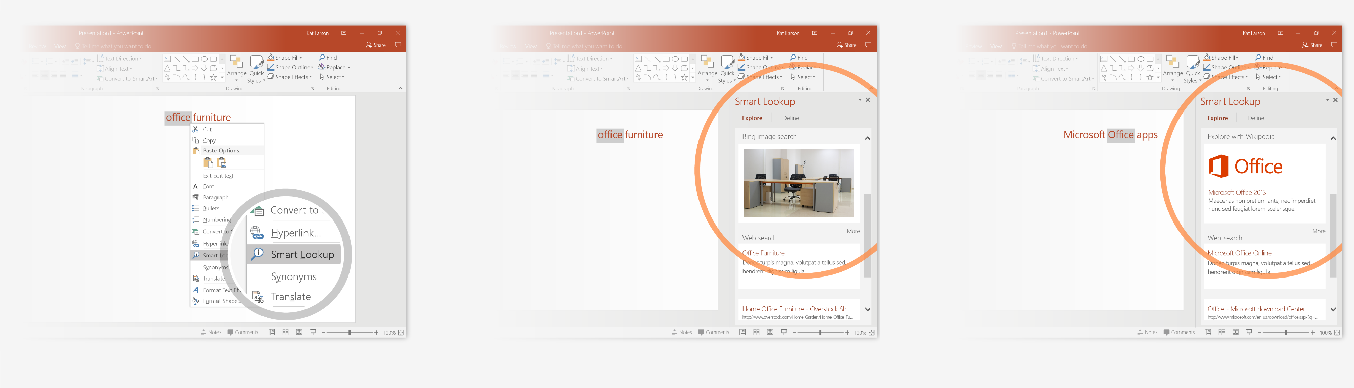
Explore without leaving your slides
Smart Lookup brings research directly in to PowerPoint. Try it:
1
Right-click in the word office in the following phrase: office furniture
2
Choose Smart Lookup, and notice that results are contextual for that phrase, not Microsoft Office apps.
3
Just for fun, try Smart Lookup again by right-clicking in the word Office in Step 2.

Slide 6

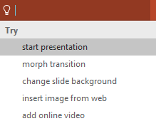

More questions about PowerPoint?
Select the Tell Me button and type what you want to know.
Visit the PowerPoint team blog
Go to free PowerPoint training
SELECT THE ARROW WHEN IN SLIDE SHOW MODE

